Slide 1
LIBERALS and CONSERVATIVES

Slide 2
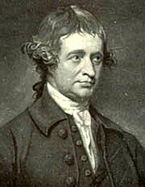
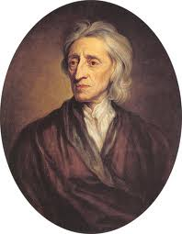
Classic liberalism v. classic conservativism
Edmund Burke
John Locke

Slide 3
What was classic liberalism?
In reaction to monarchies, which were authoritarian, liberals instead believed in individual rights, the believed in political equality, they believed in accountable governments (democracy), they believed in the rule of law, and they believed in free markets.

Slide 4
Modern liberalism and conservatism
They’re both classical liberals! (they believe in free markets and democracy)

Slide 5
Views of Markets
Modern Conservative
Modern Liberal
Believe they are efficient, free markets are the best solutions to problems
Believe market choices reflect freedom.
Believe markets are often inefficient, and are bedeviled by instability, externality, monopoly and information asymmetries.
Believe market choices often reflect exploitation

Slide 6
Views of Government
Modern Conservatism
Modern Liberalism
Believe governments are often inefficient, and reflect the lobbying of special interests, and groups receiving unearned income.
Believe government actions reflect interests of administrators, not the people.
Believe government can implement rational effective policies to support the collective good.
Believe government actions reflect the democratic will of the people, and thus freedom.

Slide 7
Individual Freedom
Modern Conservatism
Modern Liberalism
Freedom is the absence of government control. Citizens lose freedom to the extent that they are overregulated by an intrusive government.
Freedom is the ability of citizens to contribute equally. Since this is affected by economic and social factors, the government should help the least well-off so that they might enjoy their full democratic/civil rights.

Slide 8
Social Values
Modern Conservatism
Modern Liberalism
Traditional values reflect a shared morality, and it is appropriate for government to enforce it.
Values reflect individual choices. Imposing one groups values on everyone is immoral, and thus these decisions should be left to the individual.

